Slide 1
GENERO’19
CONDUCTED BY ABES(EC)
#HACKATHON..

Slide 2
FARM STUDIO..
PRESENTED BY:
-: ASHWIN SAXENA (LEADER)
-: SIDDHARTH Singh
-: MANSHI GUptA
-: VISHAKHA AGRAWAL
-: CHETAN UPADHYAY

Slide 3
**TABLE OF CONTENT
:- PROBLEM…
:- mOTIVATION …
:- IntroDUCTION…
:-LITRATURE SURVEY…
:- MODIFICATION…
:- RESULTS …
:- FUTURE SCOPE...
:- CONCLUSION…

Slide 4
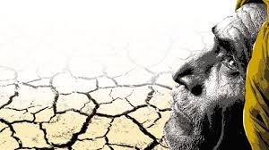
**Problems face by farmer..
The FARMERS are Not known with climatic as well as the soil condition of the Area. don’t know which crop will be more productive
In that particular Area BECAUSE of certAin specification & the nature of the soil.
They are unawrae of the future weather conditions, aleast not for upcoming Week

Slide 5
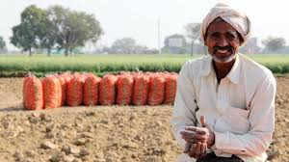
Agricultural marketing still continues to be in a bad shape in rural India. In the absence of sound marketing facilities, the farmers have to depend upon local traders and middlemen for the disposal of their farm produce which is sold at throw-away price.

Slide 6
MOTIVATION..
Because of less knowledge the farmers were not able to decide which type of soil is considered to be better for the production of which type of crop & because of sounded market facility they were also not able to get the proper productive cost of their crops.

Slide 7

To refine the Economy of the Farmer and the “Government” sell & buy infrastructu--re these action can be performed.

Slide 8
Introduction..
It can provide the basic Information which helps in the development of the farmer’s Economy and easily providing collective stock to the Government.
The platform is easily accessible and VERY handy to the user…

Slide 9

MODIFICATION
This can improve the basic Organisation structure of the Farmers selling and knowledge based process.
they also get concern about the type of soil in their Locality& which

Slide 10
RESULT:
The application can eaSily be circulated among the people over the long distance and the briefed ideas can be
many contracters can also get attracted through the system and this can be helpful by the farmers to selL their crops easily and effectively.

Slide 11

Proper informartin are earned by the Farmer’s ...
Weather Report which help farmers to invest in efficient crops
Soil Recognition using ML , Firebase
Which help farmer to understand the condition of soil for crops
Direct Market contact by farmers to avoid extra fees of products

Slide 12

It is free cost..

Slide 13
CONCLUSION:-
The problem of many Farmers were get solved by these methods & they get more conserned about the productive rate and high yield .
The Economic condition of “FARMER” as well as the “GOVERNMENT” can be Improved Easily.
Many profitable schemes can be reached to the “FARMERS” easily .

Slide 14
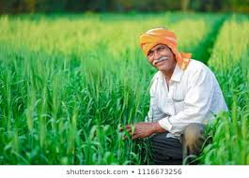
-:The possibilities of getting proper fair of the crops is Increase
-:It can be a basic way by which the Higher Authorities can up Directly with poor Farmers.

Slide 15
ANGRYNERDS…
TEAM MEMBERS-

